Slide 1
City Clusters of Toronto Metropolitan Area

Slide 2
Introduction and Business Problem
A foreign firm planning to enter the Toronto market without local knowledge
Looking for investment and development opportunities
Need a high-level understanding of the city
Explore different city districts
Demographic information
The type of existing venues
Possible competitors
A high-level of analysis to inform entry strategy and business opportunities

Slide 3
Data acquisition and processing
Neighborhood list from Wikipedia: https://en.wikipedia.org/wiki/List_of_postal_codes_of_Canada:_M
Neighborhood coordinate data from the internet: http://cocl.us/Geospatial_data
Venue data from Foursquare database
Data cleaned of un-wanted data points and format

Slide 4
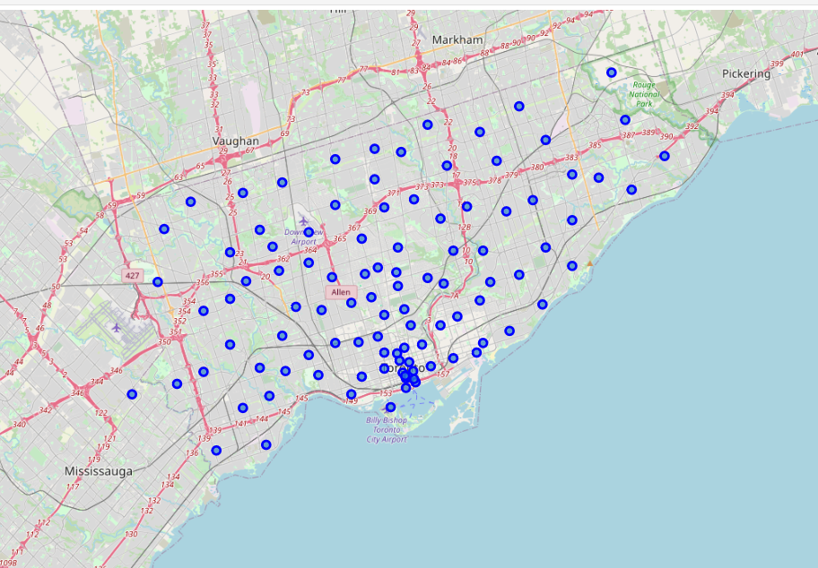
Toronto neighborhoods visualization

Slide 5

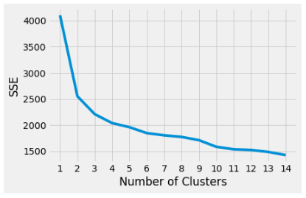
Optimal k
K-Mean clustering:
Determine the optimal K
Elbow method
Optimal K determined to be 3

Slide 6
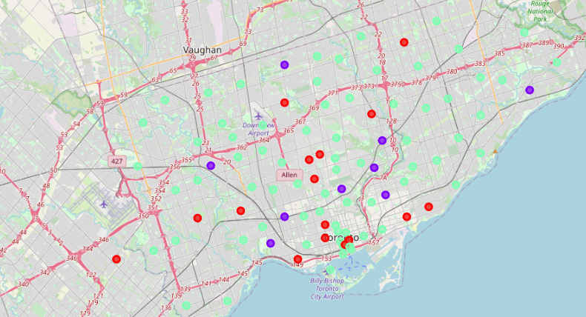
K-mean clustering
3 Clusters
16, 9, 71 neighborhoods in respective clusters
Irregularly located geographically

Slide 7
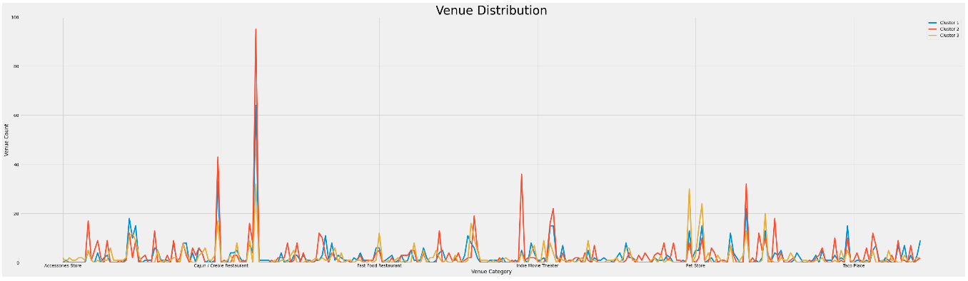
Venue Distribution

Slide 8
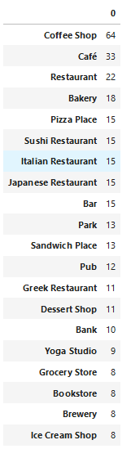
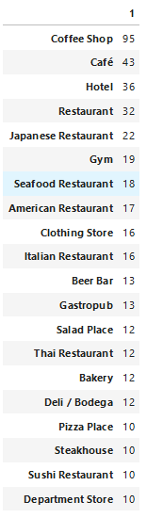
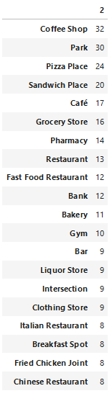
Top venues for each cluster
Coffee shop is the most in all three clusters
Different distributions among the top 10 venues

Slide 9
Cluster 3 – rural living
Relatively fewer venues
The most parks, pharmacy, and grocery store
Healthy balance of restaurants, liquor store, living supplies, and family entertainment
Has more airport-related venues

Slide 10
Cluster 2 – Downtown/business center
Most hotels, 36
Most coffee shops, 95
Most offices, 8
More sports stadiums, museums, galleries, and aquariums
More shopping centers and department stores
Signs of tourism and business activities with higher population

Slide 11
Cluster 1 – urban living
Transition area between downtown and rural
Young adults living in apartments
Restaurants make up of the majority of venues
More modern facilities like yoga studio than cluster 3

Slide 12
Conclusion
Inform potential customer group:
Rural living: family demographic
Downtown/business center: business population and tourists
Urban living: young adults
Inform investment opportunities:
Banks in cluster 2
Department stores in cluster 1
Single family homes in cluster 3
Apartment buildings in cluster 1
Future directions:
Aggregated categories
Incorporate geographical distances
Sub-clusters

